Slide 1
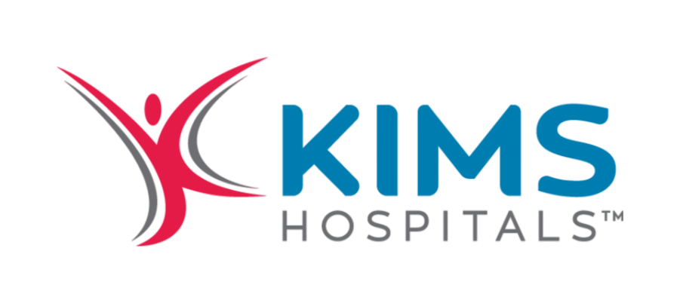
Stock Analysis Krishna Institute of Medical Sciences Ltd (KIMS)
Recommendation:
Target Price:
Current Market Price:
Upside Potential:
BUY
INR 658
INR 552
17%

Slide 2
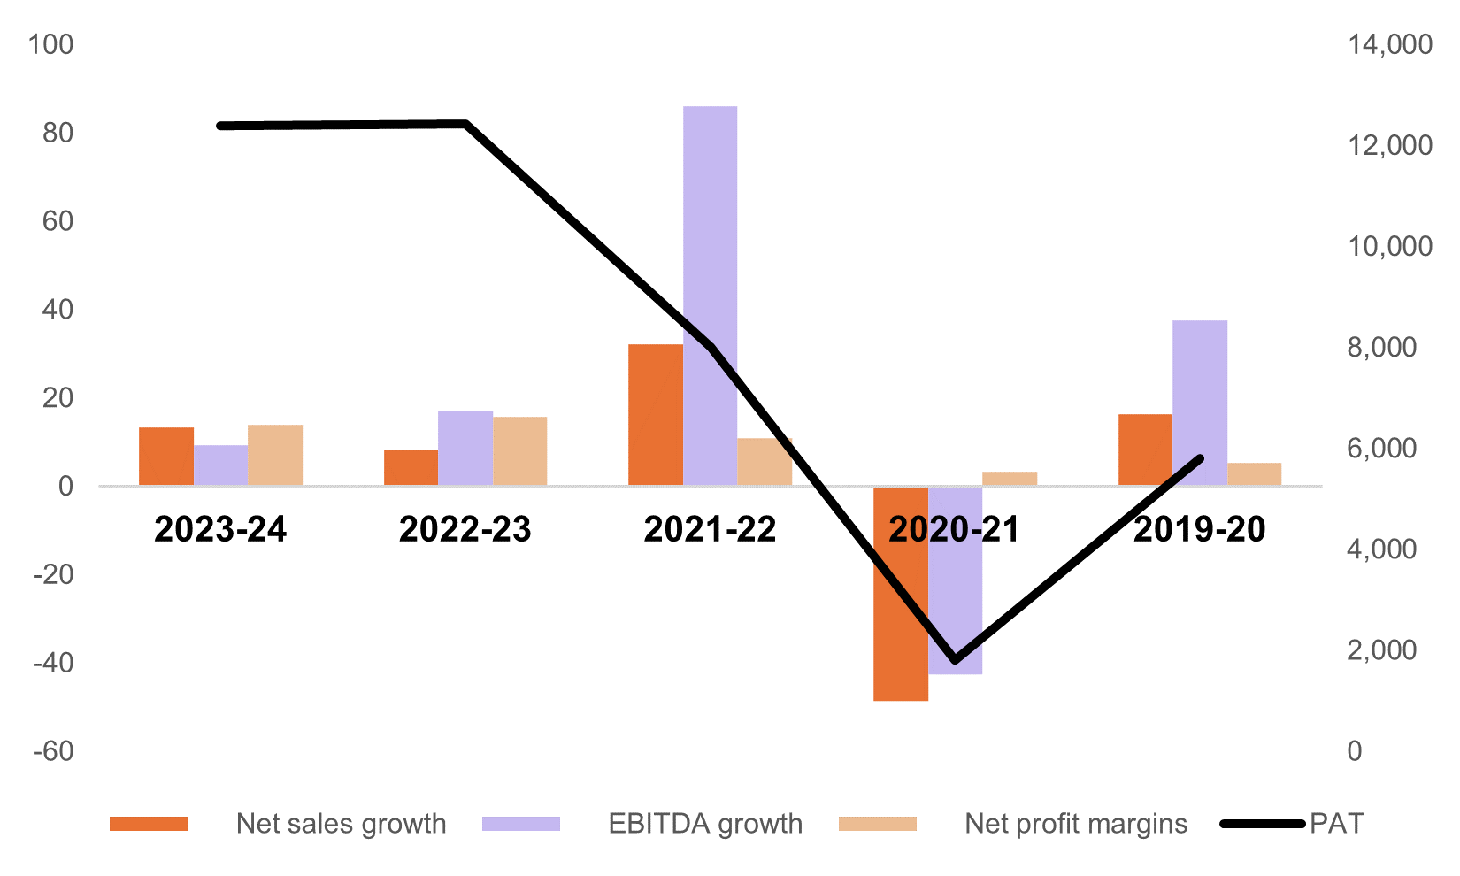




Industry Overview
Expenditure & bed density on healthcare by country
Market growth in India in terms of bed capacity
Outlook of Hospital Industry in India
$
+10%
+8%
India healthcare industry provides the lowest cost offerings compared to the developed countries.
The market is substantially underutilized, with bed density being the lowest (Δ = 2.55 times w.r.t Lo) amongst its peers.
Out of pocket expenditures exceed current health expenditure by 212.5%. The trend is opposite for most of the developed countries, and for developing countries, the OOP is bounded by x2 times of CHE.
IPDs contribute to 71% of total industry revenues, whereas the rest are contributed by OPDs.
Private hospitals dominate public hospitals in terms of the volume of treatments by 34%.
Industry growth is driven by aggressive debt-funded expansion
761.3
670.5
74.04
487
935.7
364.4
5738
12012
172.6
$
172.4
230.6
36.88
156.2
254.7
32.96
775.4
1285
69.04
+14%
+1%
-1%
+3%
+5%
3
Brazil
China
India
Malaysia
Russia
Thailand
UK
USA
Vietnam
FY20
FY21
FY22
FY23
FY24 (E)
FY25 (P)
FY26 (P)
FY27 (P)
CHE
Per capita
OOP expenditure per capita
CHE as
% of GDP
OOP expenditure as % of GDP
Bed density
(per 10k population)
Total Beds
Beds expansion
Financial Snapshot of Hospital Industry in India
Industry Growth Factors
Industry Assessment
%
Million ₹
STRENGTHS
S
Change in demographics
Rising Income Level
Increasing Health Awareness
Cost competitiveness; streamlined supplier chains
Medical innovations driven by private hospitals
WEAKNESS
W
Lack of infrastructure and skilled manpower
Public expenditure on healthcare ~ 2.2% of GDP
Growth in Healthcare Delivery
~ 11 – 13% from FY25 - FY27
OPPORTUNITIES
O
Growth of medical tourism expected at 14% CAGR
Synergies from Ayushman Bharat mission
Health Insurance Coverage
Medical Tourism
Conducive Government Policies
THREATS
T
High receivable days inhibit capital expenditure
Govt regulations reducing operational autonomy
Source – CRISIL Research, Tijori Finance, Bloomberg, Screener

Slide 3
Company Overview
About the company
Non – Financial Snapshot
Financial Snapshot
Set up in 2000, has grown to 12 speciality and super-speciality hospitals spread across Telangana, Andhra Pradesh and Maharashtra, with planned entry into Karnataka.
Pioneer in introducing several medical procedures to India, including ECMO program and Trans catheter valve replacement procedure.
Strengths across transplants, surgery, nephrology, neurology, cardiology, urology and neonatal care.
Digitalised operational and clinical workflows through use of EHR application and data analytics.
Plan to invest INR 500 to add 1,000 beds in India and GCC countries in the next three years, both organically and non-organically.
+8%
+3%
C
FY22
FY23
FY24
FY22
FY23
FY24
In-Patient volume (‘000)
Occupancy Rate %
+10%
-3%
P/B
Ratio
22,102 Cr
12.09
Mkt
Cap.
Shareholding Pattern
16.9%
ROCE
Current
Ratio
1.03
Stock
Price
30% CAGR (3yr)
ROE
FY22
FY23
FY24
FY22
FY23
FY24
22% (3yr)
Out-Patient volume (‘000)
ARPOB (‘000)
ESG Metrics
20.89% CAGR growth in EBITDA (5 year)
23.92% CAGR growth in PAT (5 year)
Partnered with an ESCO (Smart Joules Pvt Ltd) to make zero capital investment to implement energy conservation measures (ECM)
M&A developments
Blackstone acquires stake in KIMS through its investments in CARE. TrueNorth, which entered in 2017 with $200 million stake, made an exit with ~ x33 returns.
17.34% CAGR growth in total revenue (5 year)
51.5% growth in EPS
(5 year)
7.1% savings in energy consumption
118 tonnes CO2 saved
INR 17.33 lakhs of energy cost saving
Source – Annual Report FY 23-24, Corporate Presentation FY24, Bloomberg, Screener

Slide 4







Peer Benchmarking
KIMS shows promising figures with respect to invested capital and equity resources
 | Indicator
Financial Metrics | ROA (5yr Avg) | 4.40% | 5.24% | 2.76% | 8.63% | 12.24% | 1.61% | 5.44% | 5.39%
 | Cash Conversion Cycle (5yr Avg) | -26.12 | -166.97 | -124.47 | -169.45 | -81.11 | -126.77 | 673.37 | -63.17
 | Revenue | 19727 | 5663.98 | 7094.41 | 5129.26 | 2580.52 | 1977.02 | 977.15 | 3350
 | EBIDTA (5yr Avg) | 1316.5 | 801.91 | 644.73 | 528.5 | 400.47 | 83.59 | 92.47 | 366
 | Operating Profit Margin (5yr Avg) | 13.39% | 24.48% | 16.41% | 17.93% | 28.01% | 17.04% | 20.43% | 21.33%
 | Net Profit | 1077.1 | 1053.83 | 695.25 | 807.08 | 344.55 | 51.3 | 77.41 | 482
 | Net Profit CAGR | 15% | 78% | 59% | 46% | 21% | 2%** | 16% | 67%
 | Net Profit Margin | 5% | 24% | 9% | 16% | 13% | 2% | 8% | 15%
 | ROCE (5yr Avg) | 11% | 9% | 6% | 17% | 22% | 5% | 7% | 11%
 | Current Ratio | 1.13 | 1.37 | 0.45 | 1.01 | 1.03 | 0.91 | 1.46 | 2.44
 | Debt to Equity Ratio (5yr Avg) | 0.61 | 0.17 | 0.16 | 0.48 | 0.74 | 0.86 | 0.11 | 0.39
 | ROE (5yr Avg) | 12% | 7% | 5% | 18% | 21% | -8% | 5% | 9%
Non - Financial Metrics | Number of Beds | 3787 | 3787 | 4600 | 6254 | 3505 | 1932 | 1390 | 2354
 | Occupancy Rate | 68% | 75% | 67% | 45% | 50% | 60% | 48% | 59%
 | Average Daily Revenue/Occupied Bed | 59073 | 77100 | 65924 | 41370 | 38458 | 44343 | 43365 | 64035
Market Performance | Market Capitalisation | 100924.61 | 88250.88 | 44104.66 | 26714.04 | 22101.67 | 5894.42 | 3053.98 | 30166
 | Share Price (52 wk - H/L) | 7100 / 4726 | 980 / 531 | 588 / 314 | 1445 / 980 | 580 / 325 | 425 / 310 | 340 / 210 | 1514/676
 | Price to Earnings Ratio | 97.4 | 83.7 | 68.7 | 33.1 | 70 | 131 | 39.4 | 62.5
 | Price to Book Ratio | 14.55 | 10.5 | 5.76 | 9.26 | 12.09 | 7.14 | 3.05 | 10.4
 | Major Promoter Holding | 29% | 24% | 31% | 64% | 39% | 71% | 74% | 33%
KIMS has highest RoA amongst its peers
Has highest Operating Margin with Δ = 3.53%
High efficiency in capital utilisation, with industry leading ROCE
Highest ROE, with Δ = 3% amongst its peers
Source – Screener, Tijori Finance, Bloomberg | ** Net profit CAGR calculated over 3 years for HCG due to negative profits in 2020 and 2021

Slide 5
Valuation
Football Field Analysis
As of 16th September 2024, the Current Market Price (CMP) is INR 552.
As part of Discounted Cash Flow Model, the Target Market Price is INR 658.
Thus, the uptick in the valuation suggested by the analysis is around 17%.
Methodology | Comments | Valuation
Discounted Cash Flow | Base-Bear-Bull Case; 5 year DCF
52 Week Hi-Lo | Using Market Data
Trading Comparable: P/B | Using peer-average multiple with ± 10% delta
Trading Comparable: P/E | Using peer-average multiple with ± 10% delta
Broker Price | Aggregated from 15 brokers
510
849
325
580
366
448
532
650
WACC Calculation
Cost of Equity
Risk Free Rate |  | 7.37%
Beta |  | 39.00%
Equity Risk Premium |  | 8.33%
 | US ERP | 5.00%
 | Country risk premium | 3.33%
Ke |  | 10.61%
Equity Proportion |  | 57.47%
Cost of Debt
Pre-tax cost of debt |  | 8.13%
Tax Rate |  | 24.13%
Kd |  | 6.17%
Debt Proportion |  | 42.53%
WACC |  | 8.72%
406
660
CMP
TMP
Broker Estimates
S.N | Firm | Recommendation | Target Price | Date
1 | HSBC | buy | 660 | 12-Sep-24
2 | ICICI Securities | add | 480 | 27-Aug-24
3 | ULJK Financial Service | buy | 553.6 | 26-Aug-24
4 | JM Financial Institutional Securities | buy | 571 | 25-Aug-24
5 | SMIFS Limited | accumulate | 471.4 | 22-Aug-24
6 | Kotak Securities | add | 485 | 09-Aug-24
7 | Dalal & Broacha Stock Broking P. Ltd | hold | 477.8 | 09-Aug-24
8 | Avendus Spark | buy | 480 | 09-Aug-24
9 | IIFL | buy | 512 | 09-Aug-24
10 | Mirae Asset Securities | add | 487 | 08-Aug-24
11 | Prabhudas Lilladher Pvt. | buy | 480 | 08-Aug-24
12 | Anand Rathi Securities | buy | 474 | 08-Aug-24
13 | Ambit Capital Pvt Ltd. | buy | 478 | 08-Aug-24
14 | Nuvama Wealth Management Limited | buy | 512 | 08-Aug-24
15 | Asian Markets Securities Pvt Ltd. | accumulate | 406.4 | 19-May-24
502
Mean
660
High
406
Low
Source – Annual Report FY 23-24, Tijori Finance, Bloomberg, Screener

Slide 6
Valuation
Multiples comparison across industry peers
CCM valuation for KIMS
Company Name | Market Cap (Cr INR) | Enterprise Value (Cr INR) | P/E | P/B | EV/EBITDA
KIMS | 22101.67 | 23407.99 | 69.95 | 12.09 | 44.69
Max Healthcare | 88250.88 | 88450.56 | 83.74 | 10.50 | 61.10
Narayana Hrudayalaya | 26714.04 | 27924.27 | 33.12 | 9.26 | 27.26
Apollo Hospitals | 100924.61 | 105323.41 | 97.41 | 14.55 | 52.71
Fortis Healthcare | 44104.66 | 44661.27 | 68.70 | 5.76 | 43.06
Healthcare Global Enterprises | 5894.42 | 6865.71 | 131.08 | 7.14 | 36.29
Shalby | 3053.98 | 3404.62 | 39.45 | 3.05 | 23.16
Average |  |  | 74.78 | 8.91 | 41.18
Number of shares | 44
Book Price | 45.7
EBIDTA | 524
Revenue | 2581
Revenue/Share | 59
Net Profit | 344.55
EPS | 7.9
Price using P/B ratio | 407
Price using P/E ratio | 591
Enterprise Value | 21570
Debt | 1355
Equity Value (EV - Debt) | 20215
Price using Enterprise Value | 464
Free Cash Flows (Discounted Cash Flow Model)
Sensitivity Analysis (DCF)
Financial Head | FY20 | FY21 | FY22 | FY23 | FY24 | FY25 | FY26 | FY27 | FY28 | FY29
Revenue | 1,123.00 | 1,330.00 | 1,651.00 | 2,198.00 | 2,498.00 | 3,361.58 | 4,523.70 | 6,087.58 | 8,192.11 | 11,024.18
Operating Expenses | 873.00 | 954.00 | 1,129.00 | 1,598.00 | 1,853.00 | 2,452.15 | 3,299.88 | 4,440.67 | 5,975.85 | 8,041.75
Operating Profit | 250.00 | 376.00 | 522.00 | 600.00 | 645.00 | 909.43 | 1,223.82 | 1,646.91 | 2,216.26 | 2,982.44
Other Income | 6.08 | 10.16 | 20.26 | 37.41 | 16.16 | 13.66 | 31.53 | 20.34 | 48.30 | 20.43
EBIDTA | 256.08 | 386.16 | 542.26 | 637.41 | 661.16 | 923.08 | 1,255.35 | 1,667.25 | 2,264.56 | 3,002.86
EBIDA = EBIDTA (1-Tax Rate) | 209.86 | 284.37 | 408.18 | 481.01 | 482.93 | 700.39 | 952.49 | 1,265.02 | 1,718.23 | 2,278.41
Add: Depreciation | 70.61 | 69.54 | 72.67 | 129.00 | 147.00 | 167.51 | 190.89 | 217.52 | 247.87 | 282.46
Less: Changes in WC | -0.12 | -14.15 | 74.47 | 69.28 | -15.43 | -18.30 | -28.00 | -35.84 | -44.95 | -55.51
Less: Capital Expenditures | -51.47 | -93.58 | -170.00 | -572.00 | -646.00 | -710.60 | -781.66 | -859.83 | -945.81 | -1,040.39
FCFF | 228.88 | 246.18 | 385.32 | 107.29 | -31.50 | 139.00 | 333.71 | 586.87 | 975.34 | 1,464.96
Terminal Value |  |  |  |  |  |  |  |  |  | 41,307.87
 |  | WACC
 |  | 8.32% | 8.52% | 8.72% | 8.92% | 9.12% | 9.32%
Terminal Growth Rate | 5% | 848.90 | 789.38 | 737.06 | 690.71 | 649.36 | 612.26
 | 5.20% | 795.34 | 742.62 | 695.91 | 654.25 | 616.87 | 583.13
 | 5.00% | 748.23 | 701.17 | 659.19 | 621.52 | 587.53 | 556.71
 | 4.80% | 706.47 | 664.18 | 626.22 | 591.97 | 560.91 | 532.62
 | 4.60% | 669.20 | 630.96 | 596.45 | 565.15 | 536.64 | 510.57
Derivation of DCF Valuation
Key Risks
PV of Future FCFF | 2497.59
PV of Terminal Value | 27190.05
Enterprise Value | 29687.64
Less: Debt | -1019.37
Add: Cash | 49.01
Equity Value | 28717.28
# of Shares (M) | 44
Value per Share (INR) | 658.44
CMP (13th Sep 2024) | 552
Upside | 19%
Decline of utilisation in AP hospitals.
Exodus of key doctors from the flagship hospital in Secunderabad.
Impact on gross margin from inflation in medical consumables.
Decline in ARPOB from Hyderabad cluster due to declining demand for complex procedures.
Terminal Growth Rate = 5%
Source – Annual Report FY 23-24, Tijori Finance, Bloomberg, Screener, Refinitiv, Broker Reports - Credit Suisse, ICICI Securities, JM Financial

Slide 7

THANKS!
Aryan Rastogi
PGP – 1
IIM AHMEDABAD
Roll Number – PGPGC202400213
Email: p24aryan@iima.ac.in

